Slide 1
STOP & THINK!
In your handout from yesterday complete the STOP & THINK! question on page 3.
Why is it important to give and ask for reasons in science?
Notes:
BEGINNING OF DAY 2
Use this “Stop & Think” as a do now. Tell students they will be thinking about what is a scientific model and what makes for a good scientific model in this next activity.
Do not hold a class discussion at this point. Just let them do the STOP & THINK, maybe solicit one or two answers and move on. Keep this very brief.

Slide 2

Let’s develop a set of criteria for model quality to help us evaluate models, and create good models.
Individually, make a list of the most important characteristics of good models.
Write down 6 criteria of good models.
Rank all your criteria from “most important” to “least important”. Put a number in the little box on the left, with 1 being most important and 6 the least important.
Notes:
Model quality criteria- individual (10 min) Remind students that they’re looking for characteristics of GOOD models (rather than bad models). Once students are done with all pairs, tell them that we had them compare models in order to begin thinking about what makes for a good model, and what makes for a poor model. Now, they can work individually (albeit you can have them work in pairs if you prefer) to make a list of what they think are characteristics (features) of good models. They should each come up with about 6 and they can refer to the reasons they gave for their choices (for each comparison) to help them think about criteria.

Slide 3
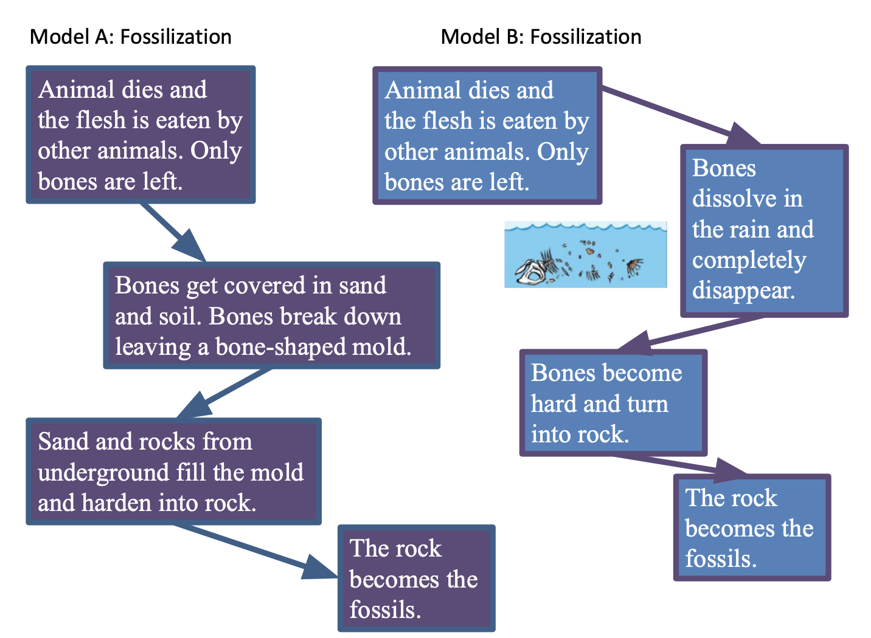
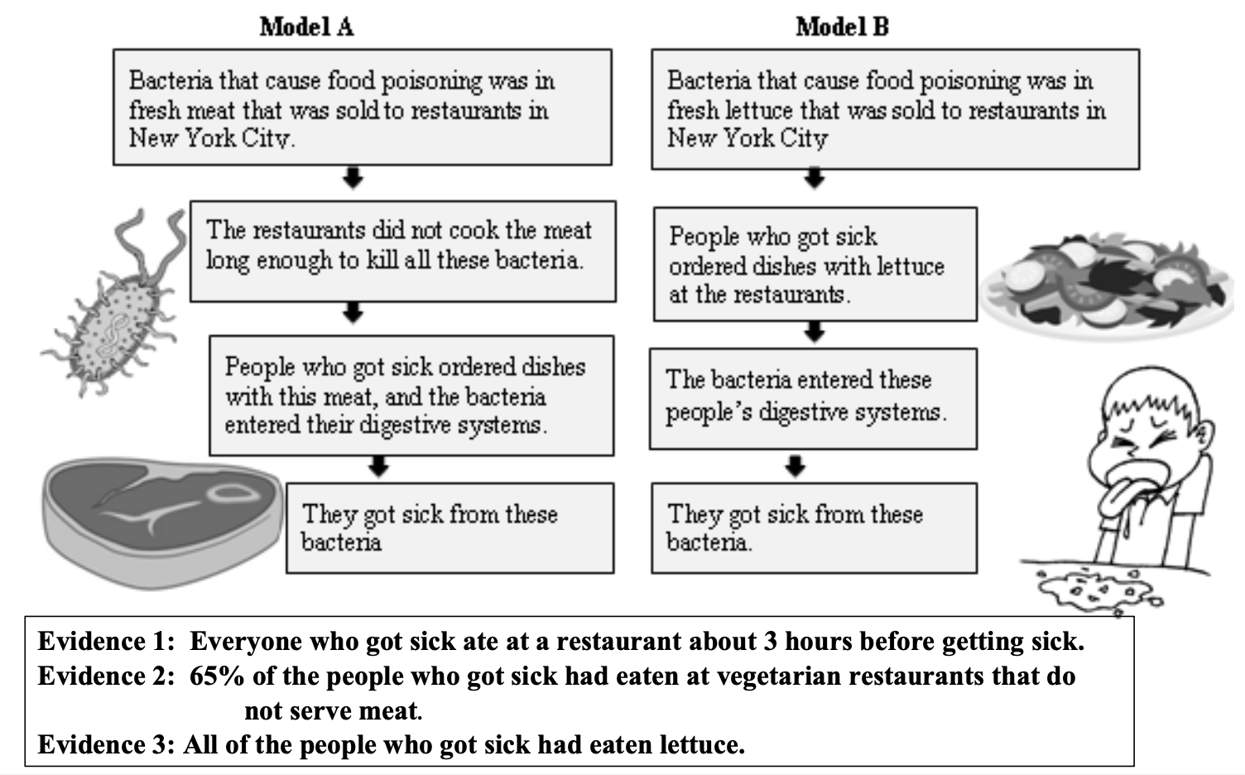
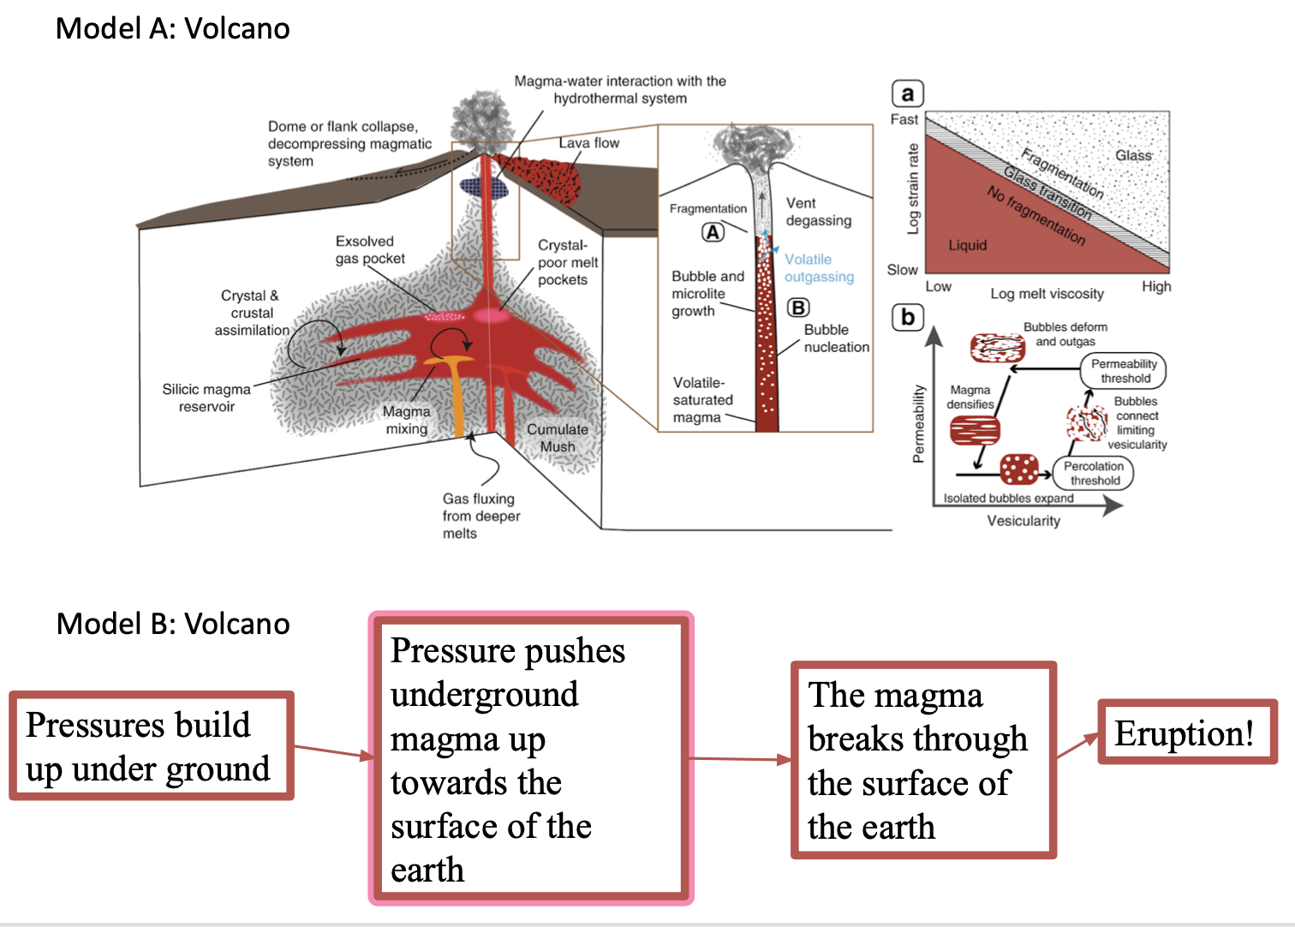
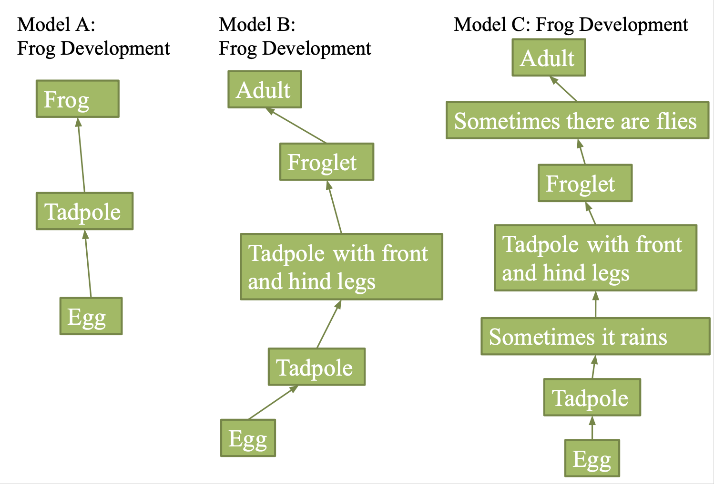
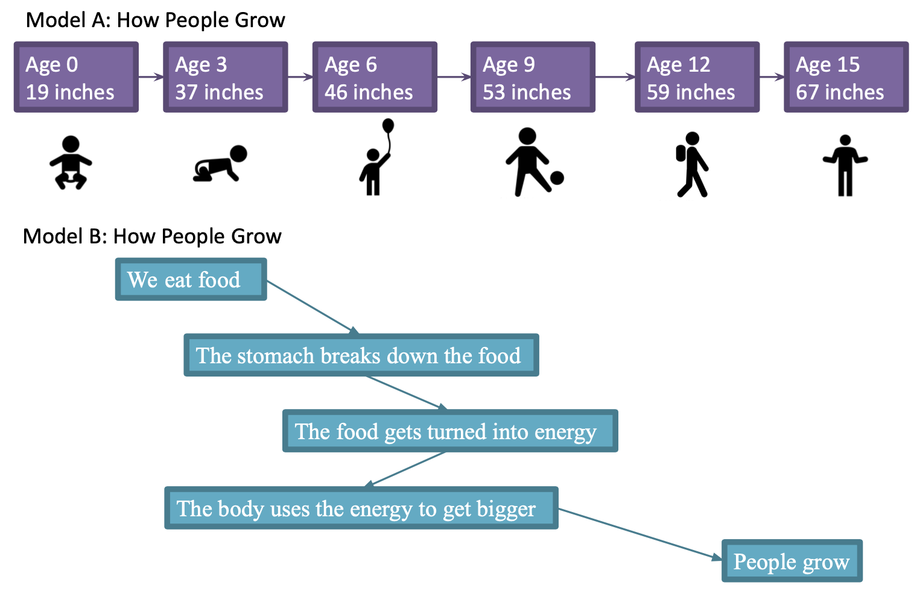
Evaluating Models
Notes:
END OF DAY 1
Evaluating models (20-25 min) Tell students that in the next activity they will continue giving reasons when thinking about and evaluating models. This time the focus is on what makes for a good model. Explain the task, as described in the slide, to the students. They need to move back and forth from individual work to pair work.
DO NOT MOVE TO THE NEXT SLIDE UNTIL STUDENTS COMPLETE THE MODEL EVALUATION.
There are 5 pairs of models and then one single model (frog). Each pair of models differs in one important aspect (which we discuss in the slides with the models- slide 8 and up). Read the notes for those slides for tips on what to push for when asking for model criteria.

Slide 4
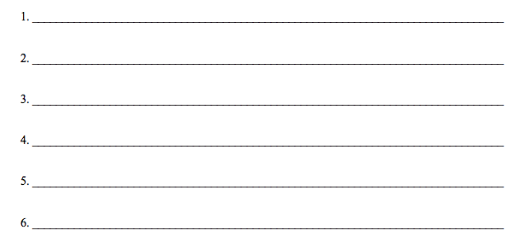
Class Criteria for Model Quality
Now let’s make a class list of criteria for good models.
We will use this list when we evaluate models, and when we create them.
From now on we will try to make models that meet all these important criteria!
Notes:
Class criteria (10 min) Once students have a list of criteria they came up with individually (or in pairs) have a whole class discussion elicit some of the criteria students wrote down. You can clump them into categories if you get several that are on the same theme. When students give their ideas, probe deeper with questions such as these, with different criteria substituted for the blanks:
Why should good models _______ (fit the evidence, be simple, show steps, be clear, fit the evidence, etc.)?
Why is it important to put this on our list?
What do other people think about [student name] criterion?
Which model shows an example of this criterion? (slides 19-26 have the models)
Which model shows a step-by-step process?
What is an example of a model you looked it that has good fit with the evidence?
Why do you think it fits the evidence well? ---REALLY IMPORTANT
What is an example of a model that is really clear?
Which of the models that you looked at was not clear?
Why do you think it was not clear.
In short encourage students to do the following 2 things:
1. Explain their reasons for why particular criteria are important.
2. Explain why particular criteria are or are not found in different models that they looked at.
Make sure that your criteria include something about evidence (e.g., fit with evidence, fit with more/best evidence, aligns with evidence) and explanation or mechanism (e.g., explains, shows the steps, shows a mechanism) 🡪 students will usually bring this up on their own, but if not try to elicit it from a group that had it on their list.
If no students have it on their lists or bring it up, bring up model set 2 (food poisoning) and discuss (evidence) and bring up model set 5 (growing) and discuss (mechanism).
Example criteria can be (don’t just use these, make sure your class criteria come FROM THE CLASS).
Models show how a process happens
Models are clearly labeled and easy to read
Models explain the evidence available
Models have a purpose or goal, they answer a question
Models need to include all relevant information (that the audience needs)
Models should not include irrelevant and distracting information (text or pictures)
It helps if models have both text and diagrams

Slide 5
BEFORE YOU GO
Complete the BEFORE YOU GO question on the handout.
Think about the class criteria list that you made. Which two criteria from the last list are most important? Why do you think so?
Notes:
Use this “Before You Go” as an exit ticket.
Tell students they will be figuring this out in future classes.
Do not hold a class discussion at this point, and keep it brief at the end of class.

Slide 6
Model Comparison Pairs
Notes:
There are 5 pairs, try to have students do as many as they can, and at LEAST the first 3. Don’t discuss each pair, let them work through all the pairs, and make sure they are on task. This should not take forever about 20-25 min for 5 pairs and the frog model.

Slide 7
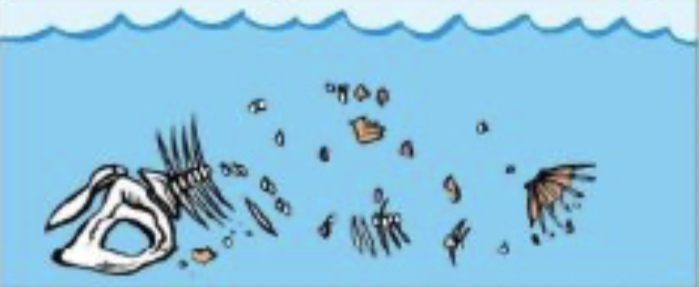
1. Which of these two models is better if you want to explain how fossils form?
Model A: Fossilization
Model B: Fossilization
Animal dies and the flesh is eaten by other animals. Only bones are left.
Animal dies and the flesh is eaten by other animals. Only bones are left.
Bones dissolve in the rain and completely disappear.
Bones get covered in sand and soil. Bones break down leaving a bone-shaped mold.
Bones become hard and turn into rock.
Sand and rocks from underground fill the mold and harden into rock.
The rock becomes the fossils.
The rock becomes the fossils.
Notes:
Differences between models:
Model B has a contradiction – it’s not possible that the bones both dissolved and washed away AND became hard and turned into rock.
Model B is inaccurate, its WRONG – bones do not turn into rock

Slide 8
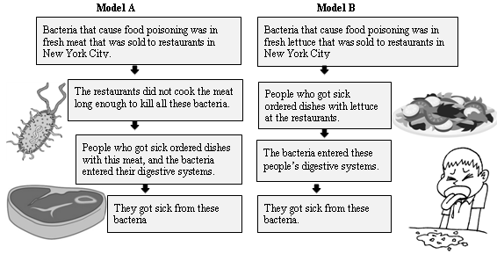
2. There was a huge outbreak of food poisoning in New York City. Health scientists developed two models of why the food poisoning occurred.
Evidence 1: Everyone who got sick ate at a restaurant about 3 hours before getting sick.
Evidence 2: 65% of the people who got sick had eaten at vegetarian restaurants that do not serve meat.
Evidence 3: All of the people who got sick had eaten lettuce.
Notes:
Differences between models:
Model A does NOT fit the evidence- it postulates meat as the cause but 65% of the people who got sick did not eat meat, and all the people who got sick had eaten lettuce.
Both models fit the first evidence, but only model B can explain the second evidence. The second evidence contradicts model A

Slide 9
3. Which of these three models is a better explanation of the development of a frog?
Model A:
Frog Development
Model B:
Frog Development
Model C: Frog Development
Adult
Frog
Adult
Sometimes there are flies
Froglet
Froglet
Tadpole
Tadpole with front and hind legs
Tadpole with front and hind legs
Egg
Sometimes it rains
Tadpole
Tadpole
Egg
Egg
Notes:
Model A is just wrong – moths/butterflies go through the cocoon transformation, frogs don’t!
Model B has more steps, and therefore explains more.

Slide 10
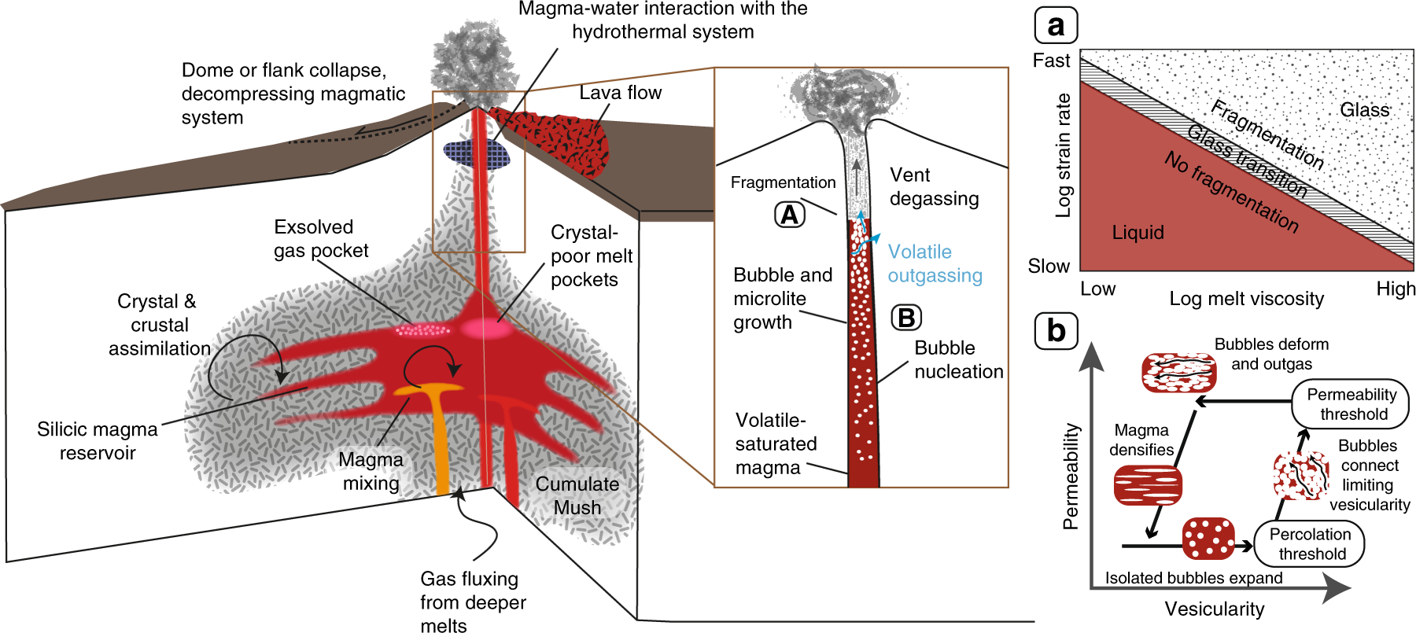
4. Which of these two models is better if you want to explain why volcanoes erupt?
Model A: Volcano
Model B: Volcano
Pressure pushes underground magma up towards the surface of the earth
The magma breaks through the surface of the earth
Pressures build up under ground
Eruption!
Notes:
Differences between models (this should help students understand the usefulness of box-and-arrow models):
Model A is prettier
Model A is very complicated, with too many details: you can’t see what’s going on
does model A not include mechanisms?
Model B isn’t as pretty
Model B is clearer: you can see the steps and understand how volcanoes form

Slide 11



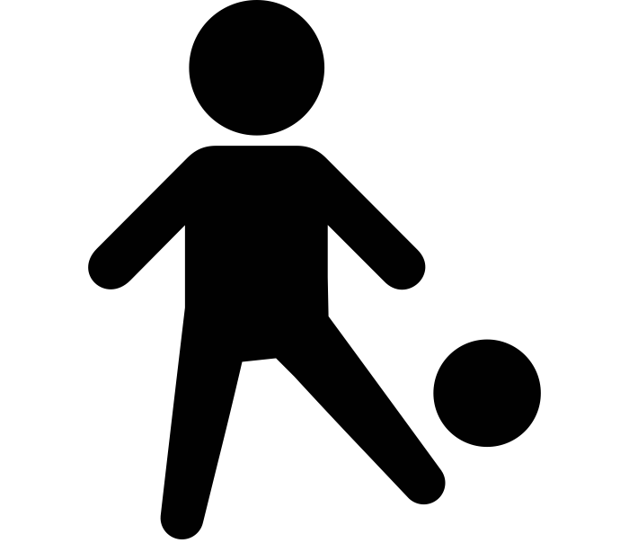


5. Which of these two models is better if you want to explain how people grow?
Model A: How People Grow
Age 0
19 inches
Age 3
37 inches
Age 6
46 inches
Age 9
53 inches
Age 12
59 inches
Age 15
67 inches
Model B: How People Grow
We eat food
The stomach breaks down the food
The food gets turned into energy
The body uses the energy to get bigger
People grow
Notes:
Differences between models:
Model A does not explain, it just shows the phenomenon without explaining WHY it happens 🡪 this doesn’t answer the question
Model B explains it a bit better (answers the question). It’s not clear that the pictures add anything here… could do without them (again, we’re trying to move kids away from wanting pictures.

